Slide 1
Data Mining for Wearable Sensors in Health Monitoring Systems: A Review of Recent Trends and Challenges

Slide 2
Data Mining Tasks for Wearable Sensors
Prediction(identify events which have not yet occurred)
Anomaly detection (identifying unusual patterns)
Diagnosis (where a decision making process is made to often categorize the data into different groups depending on the diseases)

Slide 3
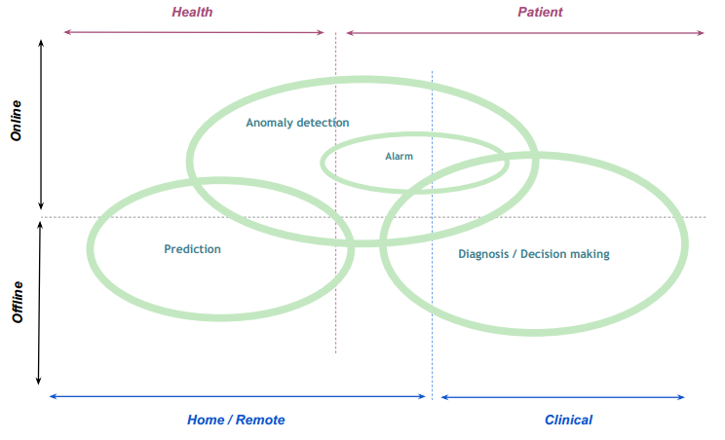
Main data mining tasks in relation to the different aspects of wearable sensing in the health monitoring systems.

Slide 4
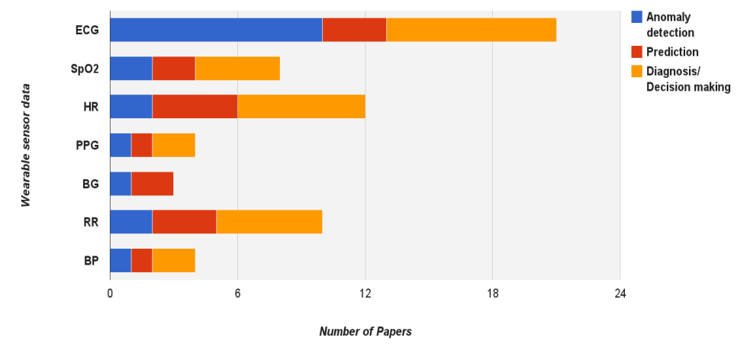
The outline of the distribution of three data mining tasks in relation to the vital signs measured by wearable sensors considering in this review

Slide 5
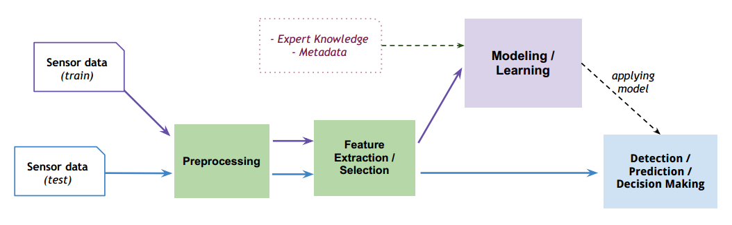
Data Mining Approach

Slide 6
Modeling and Learning Methods
Support Vector Machines
Neural Networks
Decision Trees
Gaussian Mixture Models
Hidden Markov Models
Rule-Based Methods
Statistical Tools
Frequency Domain/Wavelet Analysis
Other Methods
Mining tasks, characteristic, suited field

Slide 7
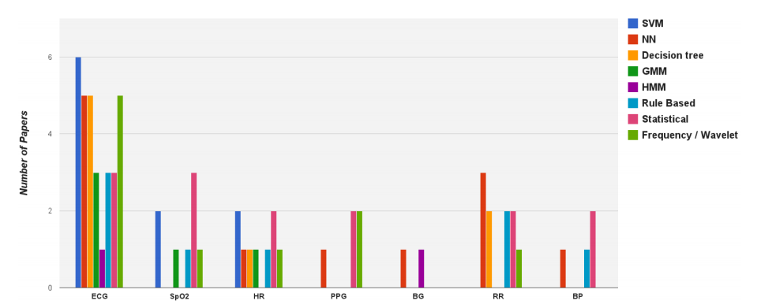
The outline of the application of data mining methods in relation to the vital signs measuring with wearable sensors.

Slide 8
Type of input data and its properties
Data Acquisition
Experimental wearable sensor data
Clinical or online databases of sensor data
Simulated sensor data
Data Properties
Time Horizon (long term/short term)
Scale (large/small)
Labeling (annotated/unlabeled)
Continuous/Discrete
Single Sensor/Multi Sensors

Slide 9
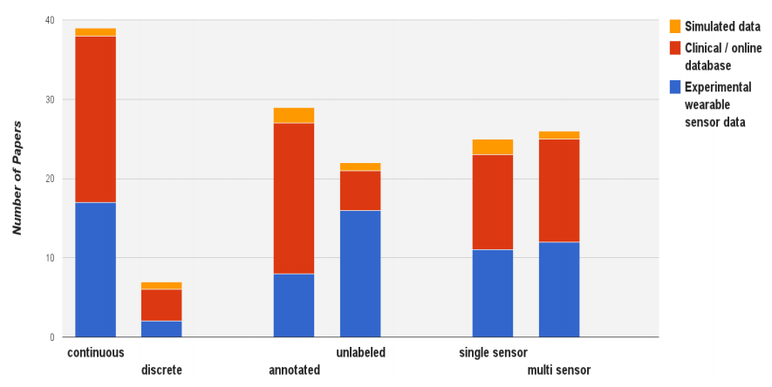
The distribution of works on three sensor data properties (continuous/discrete, labeling, single sensor/multi sensors), with the relation to three types of data acquisition

Slide 10
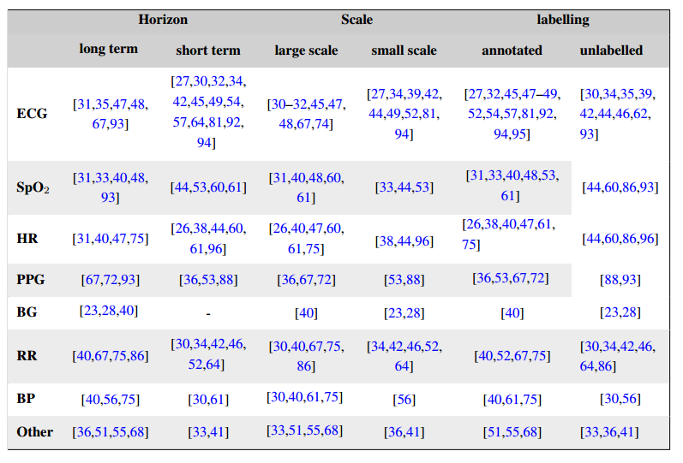
The outline of the categorization of selected papers based on the type of wearable sensor data and data set properties.

Slide 11
Discussion and Future Challenges
Guidelines for applying data mining methods
Challenges

